Slide 1

450
The World’s Largest Garage Sale – On Your Mobile Device

Slide 2

Value Proposition for Bakkle
Everyone has items in their house that have Outlived Their Usefulness
We either throw them out, given them away, or “try” to sell them
Garage sales suck. Ebay is a pain in the ass and costly. Craigslist is complicated and creepy.
Let’s Connect Buyers and Sellers and make it absolutely possible to:
Sell Anything You Own with FOUR Clicks
Buy Anything You Find with FOUR Clicks
Make Browsing Bakkle Easy, Fun, and Even Addicting
Facilitate Easy Payments and Reduce Risks of Cash
Charge a “Connection Fee” and a “Transaction Fee”
Connection fee is credited towards the Transaction Fee
Broad Consumer Deployment Leads to Bakkle Business
Large campaign to bring Big Box retailers to “data rich” consumer base
Maximize impressions, advertise “deals” and yes, dispose of remnant inventory
This is the ultimate cash generating vehicle for Bakkle

Slide 3



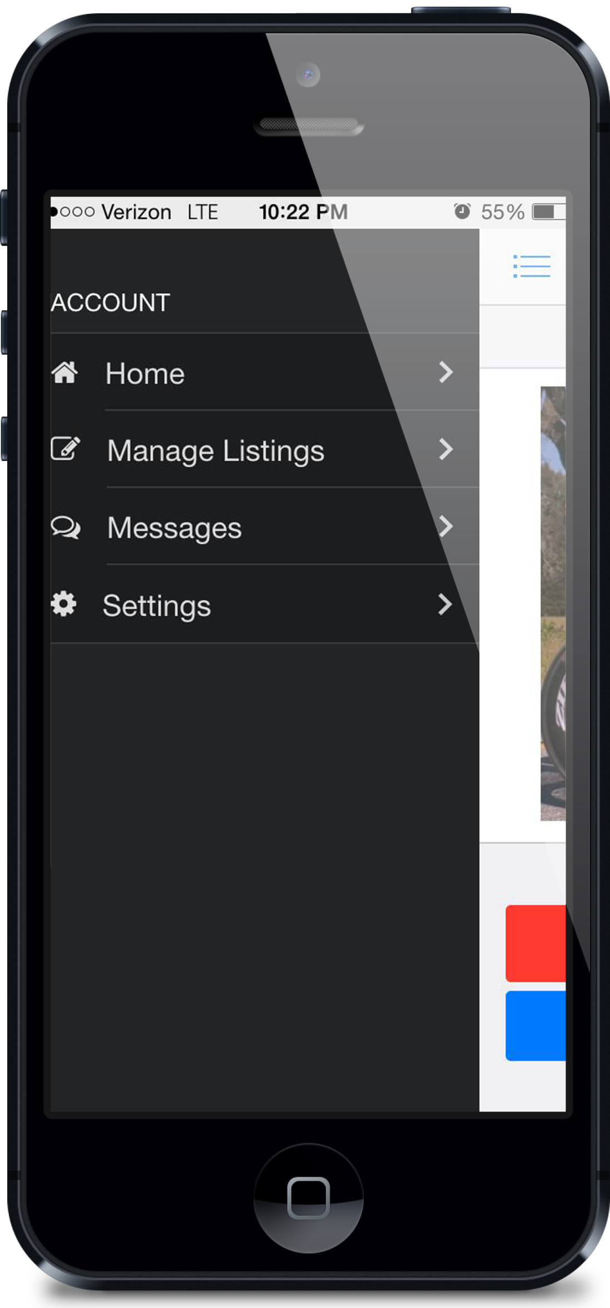
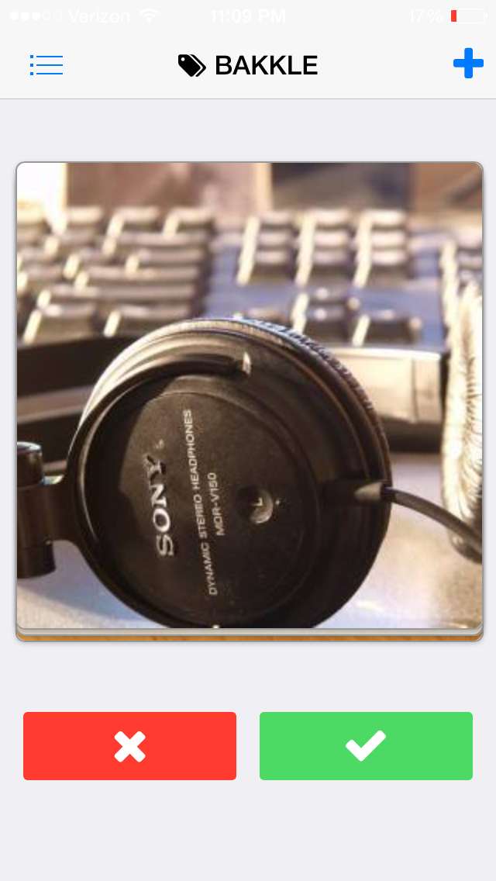
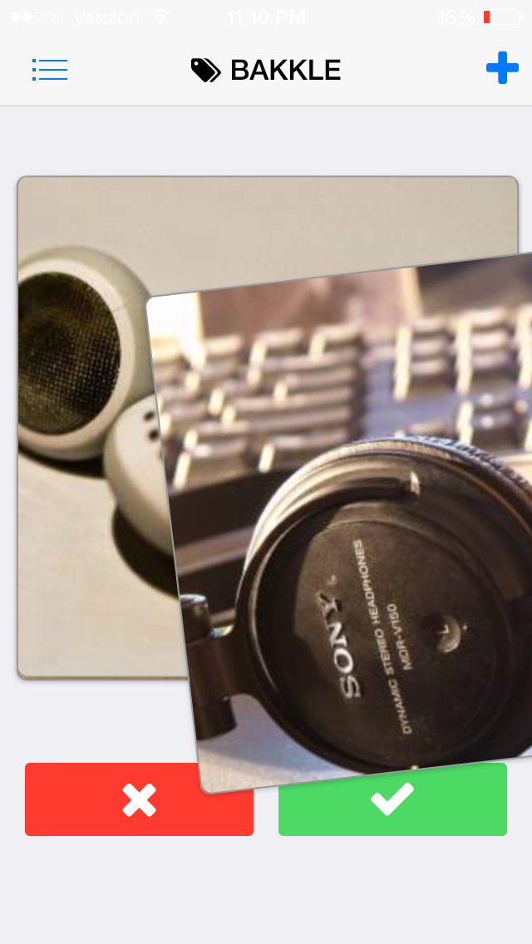
How does Bakkle Work?
Think meets meets
Bakkle uses the user friendly features of the most popular “connection” apps
Tinder’s rapid review interface
ebay’s mass listings and payment east
Uber’s elegant proximity and location technology
These features combine to allow users to list, sell, browse, and buy any item
One’s man Junk…
Eliminating transactional friction between buyer and seller
Distance, Locating, Perusing, Cash,
Unfamiliarity
Trust
This is “Wealth Transfer”

Slide 4
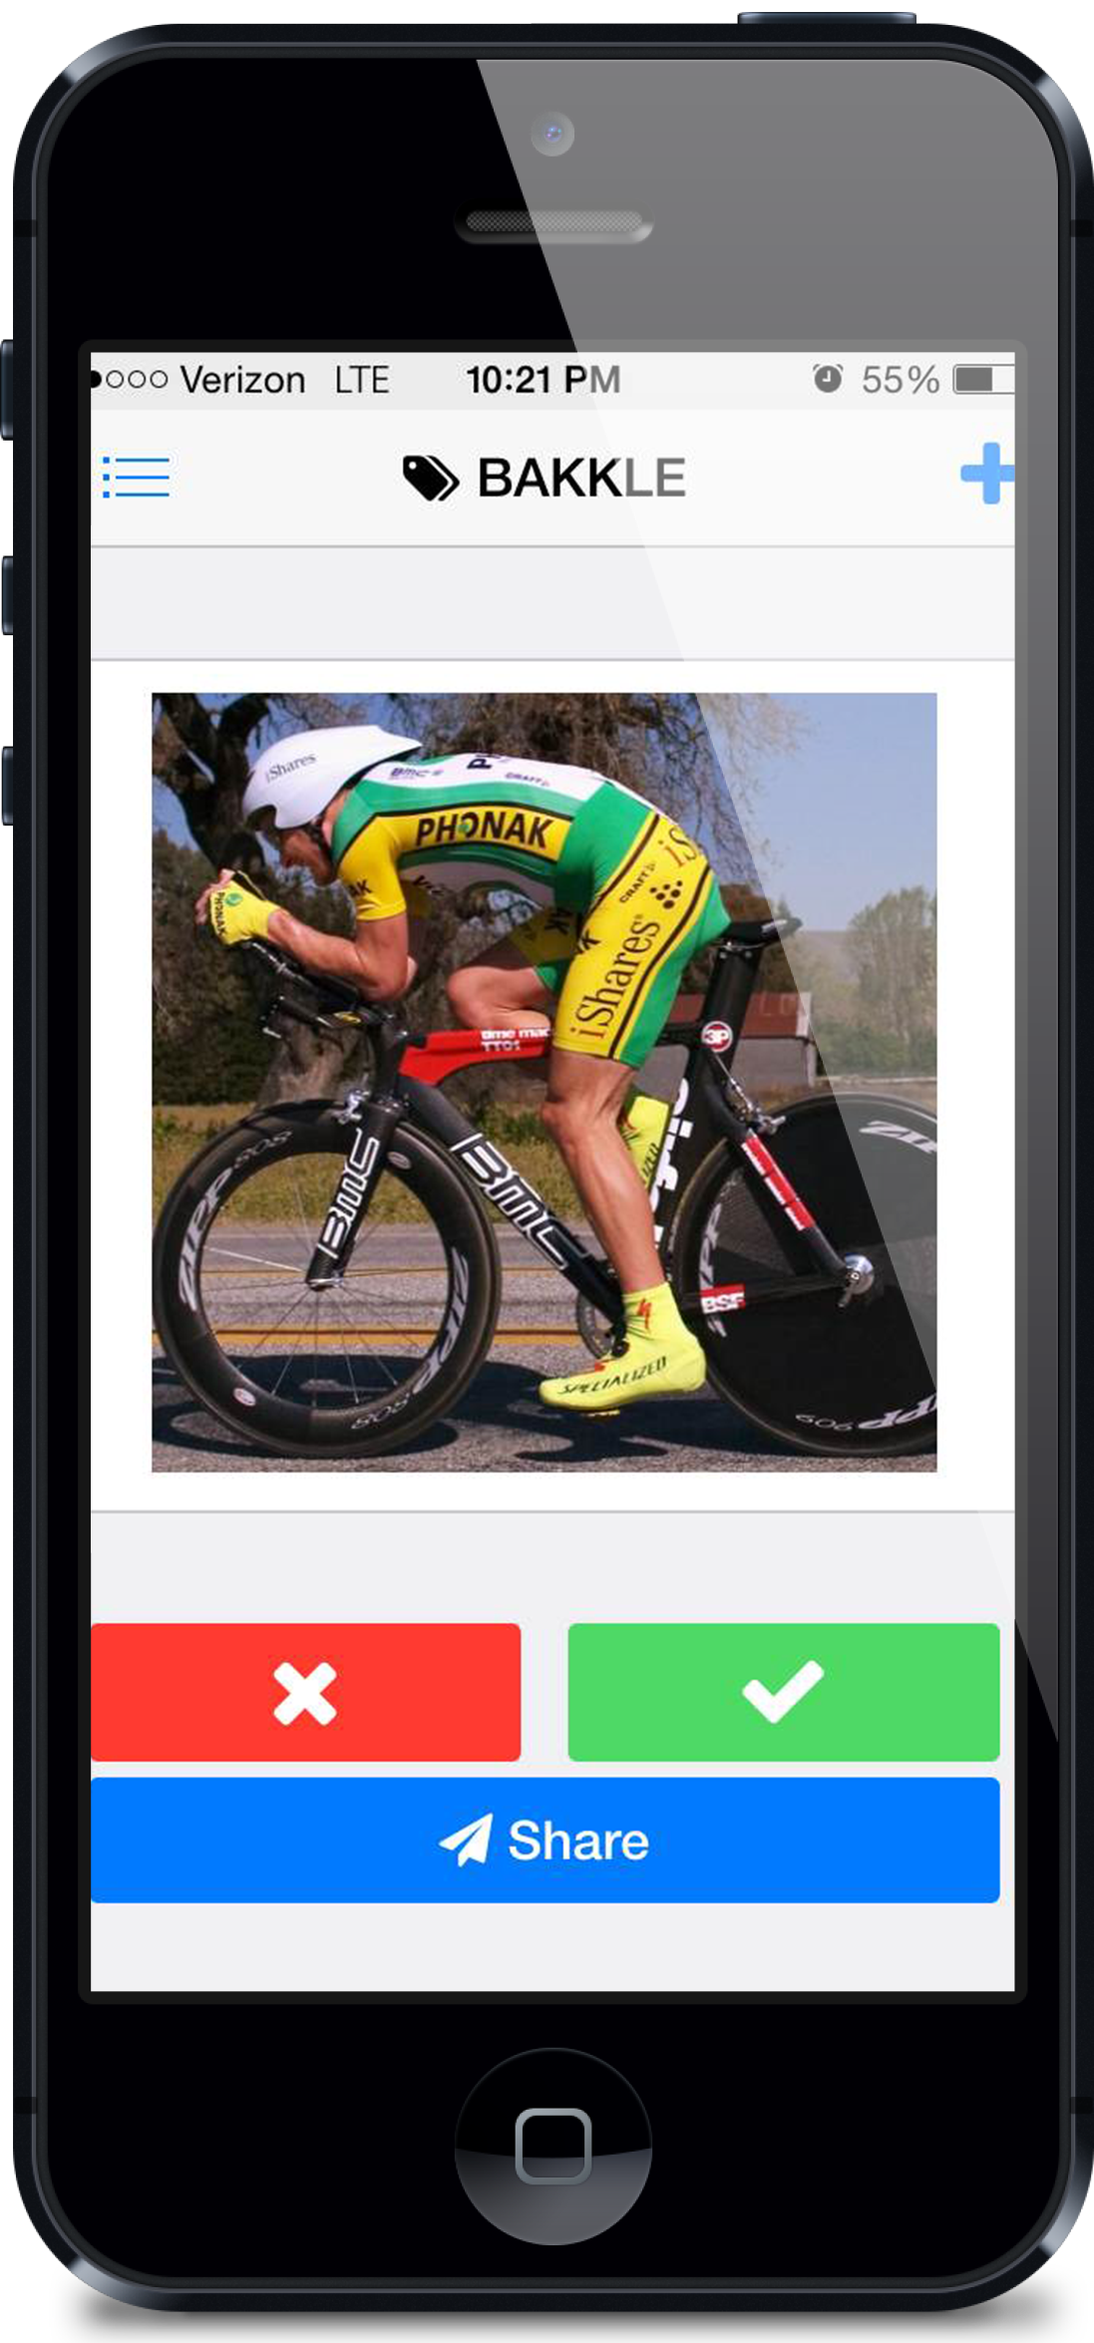
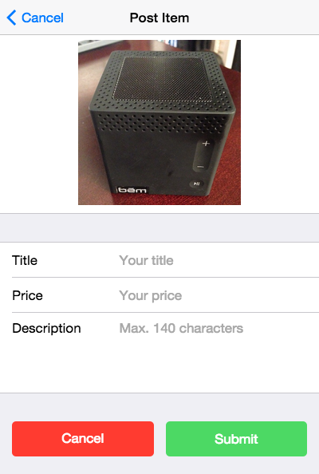

Home Screen – The Feed
“Holding Pattern”
10 items held for 5 minutes
“Meh”
Item Deleted from User Feed
“Want”
Move to Buyer Mode
“REPORT”

Slide 5
Home Screen – The Feed

Slide 6
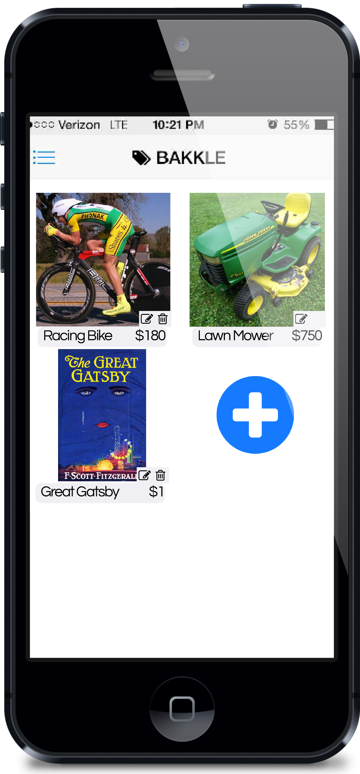
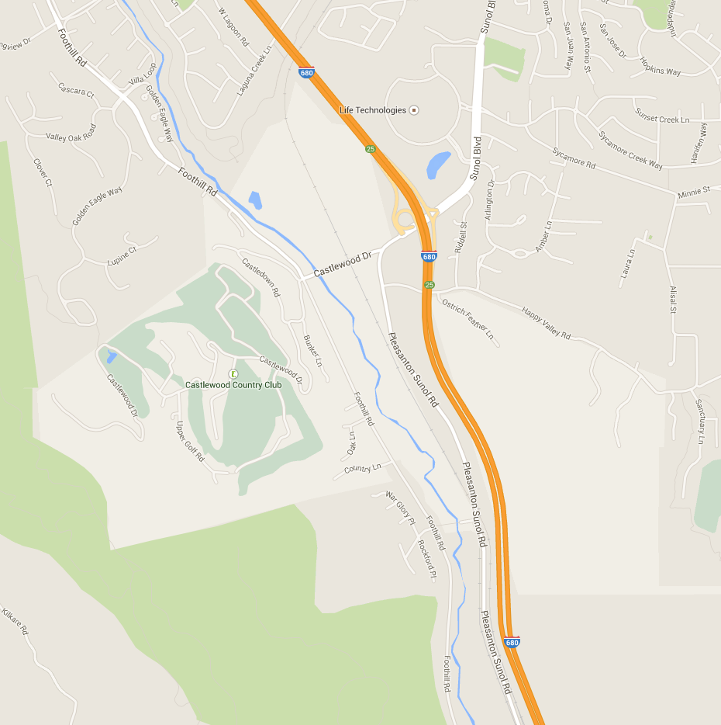
Setup User Interface
Dashboard (Mobile or Web)
Feed
Sellers Garage
Review current listing status (time remaining, price)
Activity tracker per listing?
Buyers Trunk
Review items awaiting SELLER Decision
Holding Pattern
Facebook, gMail, Visa, Mobile #, Paypal Twitter, Snapchat, Google+, Credit Bureau
Feed Parameters
Max number of items (which determines radius)
Max distance (which determines number of items)
Maximum dollar amount (could lead to LARGE radius)
Pickup, Delivery, Mail, Meet
Duration of listing (within X hours?)
Verified Buyers (yes/no)
User rating (min rating of X out of 5)
Settings
Name, Contact, gender, other demographics
Unique User Name, Photo, and Password
Payment Method,: Visa, PayPal, Venmo, other
1 Mile
2 Mile

Slide 7
Feed Interface and Logic
“I Really Need It”?
“Confirmation of your NEED is a binding contract to purchase the item from the SELLER provided the SELLER accepts.”
“Want”
Move to confirm screen
Message and Buyer info sent to Seller Item List
Buyer Offer is valid for 24 Hours Unless Item is Sold to Different Buyer
Item is listed in “Buyer Trunk”
(Auto delete if Seller transacts with other BUYER or time expires)
Back to the Feed
Keep Shopping
All Buyer orders are canceled IF seller agrees
A confirmed sell is billed and is good forever
A

Slide 8
Feed Interface and Logic
Item never reappears
A reposted Item Never reappears in the Buyers feed
Feed # must be the same to allow exclusion from user
Data collection
Time on screen
# Clicked to view
Did user LEAVE APP to research product
Any “Needs” that were cancelled?
“Meh”
Item Deleted from User Feed
A reposted Item Never reappears in the Buyers feed
Item Reviewed by BAKKLE
If Inappropriate Removed from “The Feed”
User status evaluated
Warnings
Fines
Deletions
“REPORT”

Slide 9
Seller’s Garage
Number of “wants” in seen
Click on item
List contains (sortable)
Picture of Buyer
Buyer User name
Buyer Rating
Time of Swipe
Time Last on App
Current distance from Seller (if available)
Verified user
Seller selects buyer “It’s Yours”
Transaction Complete
Chat Room is intiated
Add New Items

Slide 10
Buyer’s Trunk
Item List of “Want”s
List contains
Item Icon Picture
Distance to Seller
Price
Items “disappear”
Listing expires
Seller selects other
Transaction completed
Add New Items

Slide 11
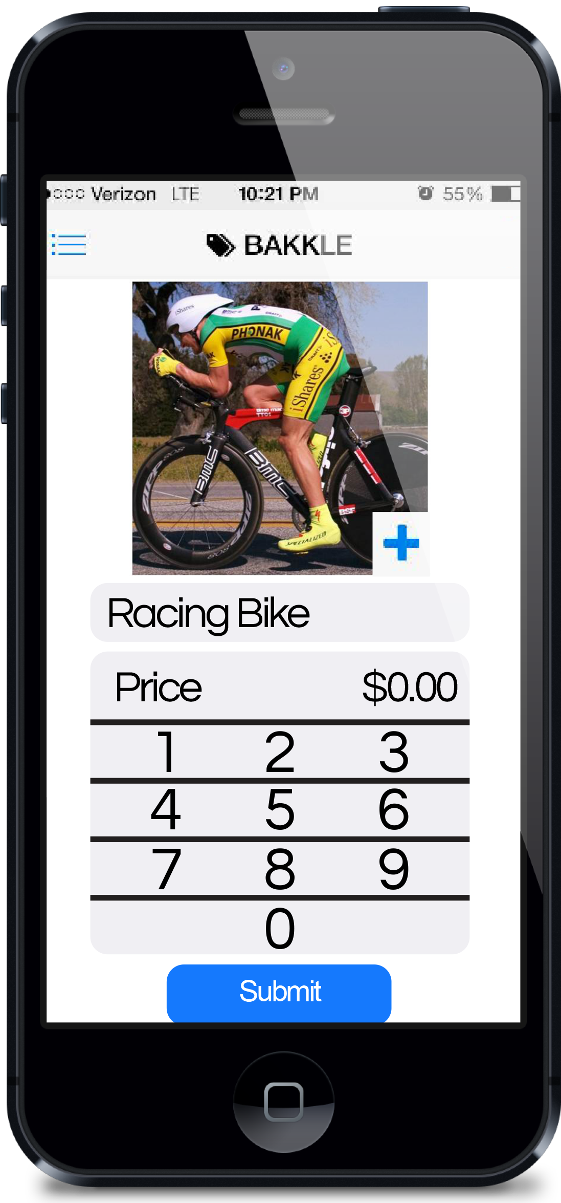
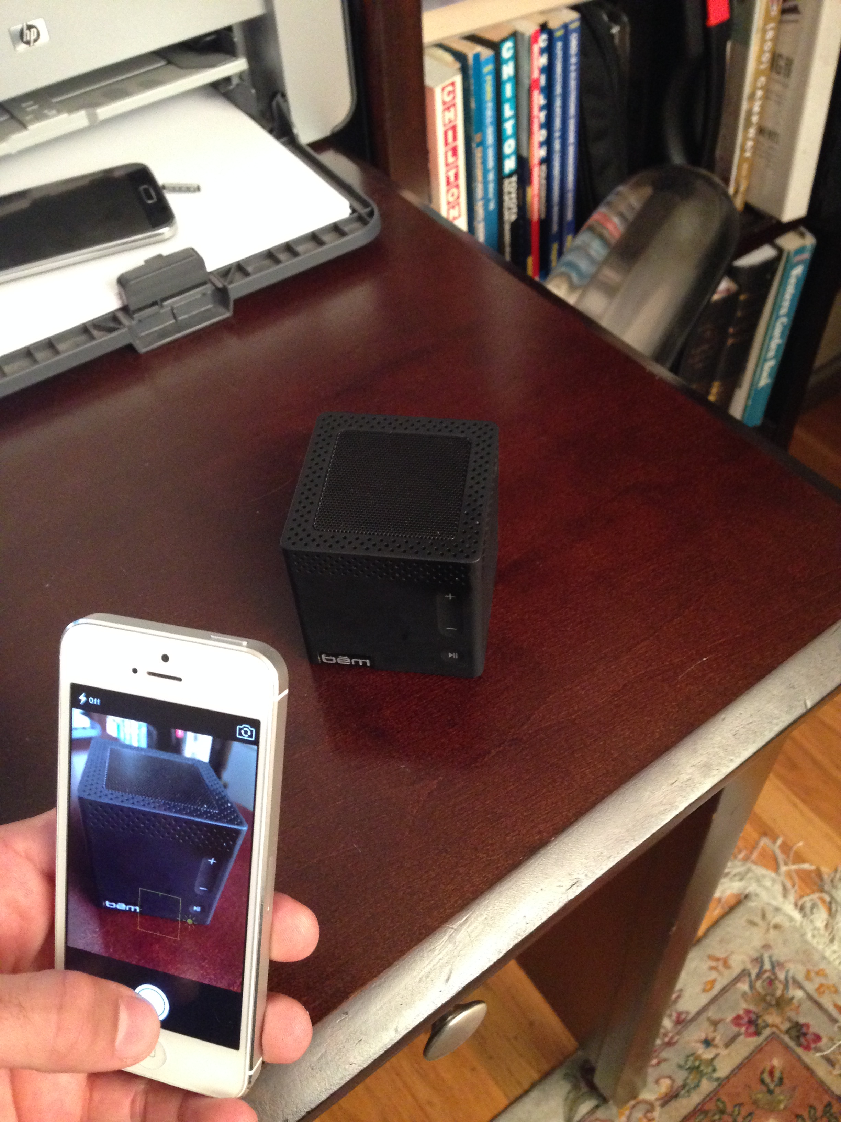
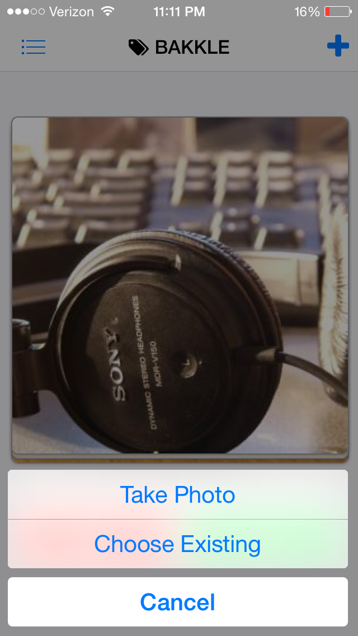
Seller’s Listing
FEED
Click to Set Up
Picture
Filter selection
Type Description
Type Price
Select Delivery Method
Click to Post
Back to the Feed to see your Post

Slide 12

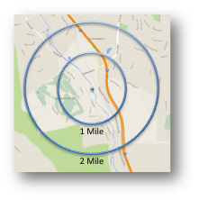


When You’re Ready To “Bakkle”
Users agree to a mutual location and once are “within proximity” Pay system is activated
Avoid mistaken payments
Allow Buyer to inspect item
Motivate seller to list only legit items
Allow Pre-Authorization time
Item Description
Seller Feedback
SELL
$19.00*
Pre-Authorized
*includes BAKKLE fee
Meet HERE!
1 Mile
Item Description
Buyer Feedback
Item Feedback
2 Mile
Accuracy of Listing
Value
BUY
$21.00*
Your Purchase was Pre-Authorized
*includes BAKKLE fee
Recommend BAKKLE?

